Slide 1
Speaker Identification
CMT Data Science Interview Project
Divyesh Jagetia | 9th July 2025

Slide 2
Project Overview
Goal: Classify which of 9 speakers uttered a vowel, using LPC transformed audio
Deliverables:
Predict Speaker Labels on the test set.
Code for feature extraction and modeling.
Summary Report and analysis.
Challenges:
Non- standard time-series format.
Varying sequence lengths.
Small dataset.

Slide 3
Understanding Data
The raw input is structured like a collection of mini time series, one per speaker utterance. Understanding this structure was key to building an effective feature extraction strategy and choosing suitable models.
Data and Pattern Analysis

Slide 4
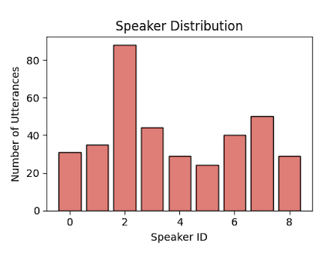
Class Distribution Analysis
Training blocks: 370
Number of speakers: 9
Most samples: 88(S2)
Least samples: 24(S5)
Imbalance ratio: 3.67
Notes:
Need of stratified sampling and class weights to normalize the data

Slide 5
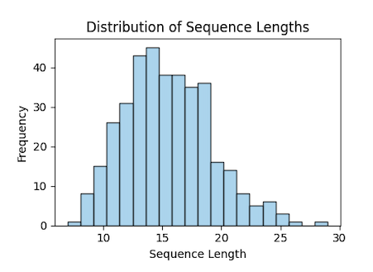
Sequence Length Analysis
Range: 7 to 29 time steps
Mean: 15.37
Feature: 12 LPC coefficients

Slide 6
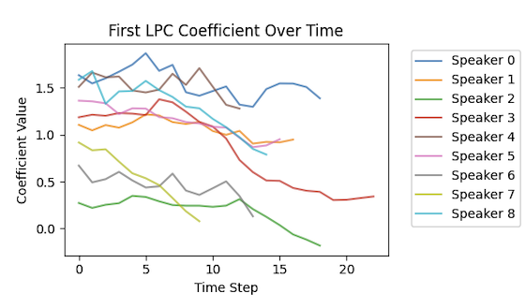
First LPC Coefficient Pattern over time
The first LPC coefficient over time captures the dominant shape of the vocal spectrum at each moment. It reflects how the speaker’s sound evolves over the utterance, and is especially valuable for distinguishing speaker identity through subtle acoustic cues.

Slide 7
Feature Engineering
Each utterance (block) was transformed into a fixed-length vector using summary statistics, specifically, the mean, standard deviation, minimum, and maximum of the 12 LPC coefficients across time points. This resulted in a 48-dimensional feature vector per block. This approach preserves essential temporal patterns while enabling traditional tabular models.

Slide 8
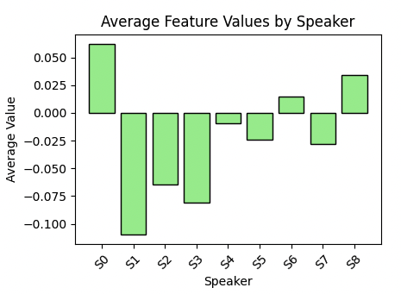
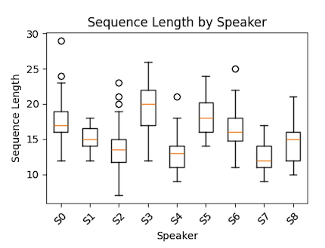
Pattern Understanding

Slide 9
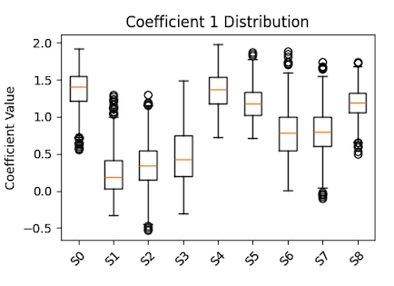
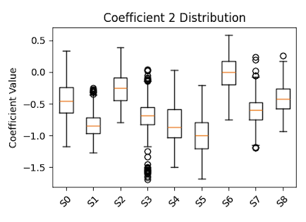
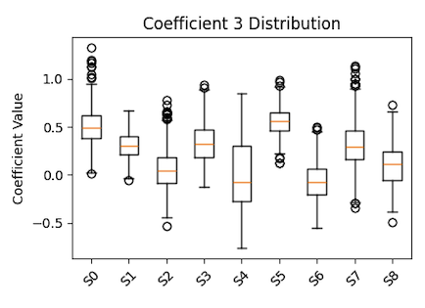
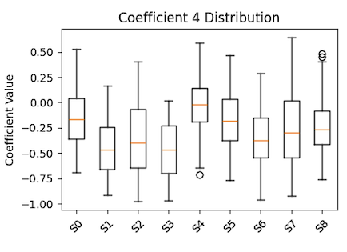
12-LPC Feature Distribution

Slide 10
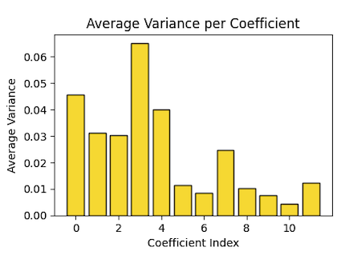
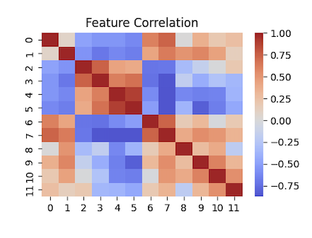
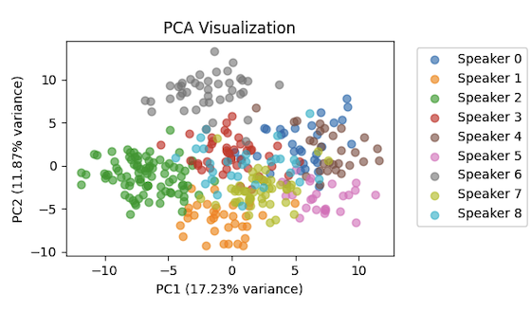
Feature Engineering 12 LPC coefficients

Slide 11
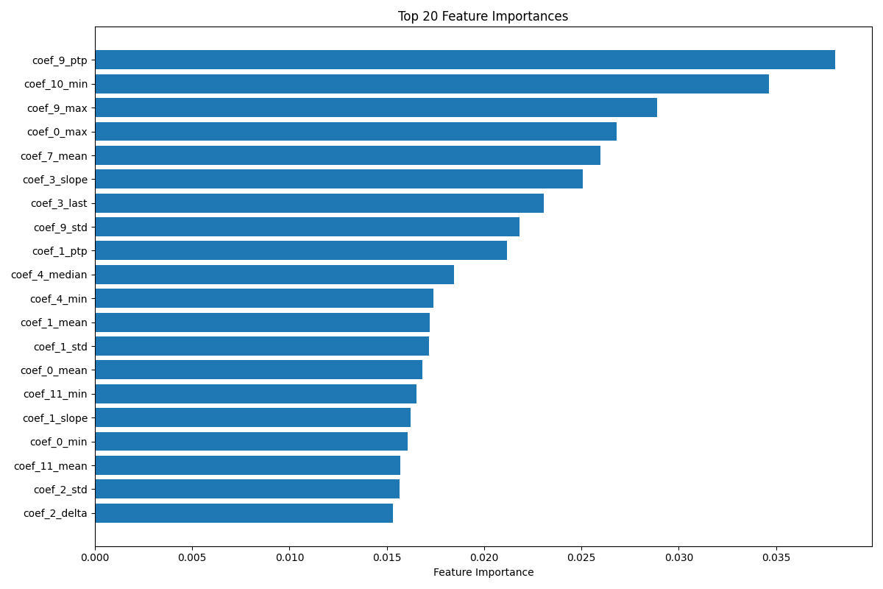
Extracted Feature Importance
Statistical Moments
Mean
Median
Standard Deviation
Min
Max
Peak-to-Peak
Temporal Features
First & Last & Delta Values
Trajectory
Slope
Curvature
Energy and Spectral Features
Sequence Length
Average Energy
Energy Variability
Feature matrix shape: (370, 138)
Notes:
Feature matrix shape: (370, 138)

Slide 12
Modeling Approach
To solve the speaker identification problem, I designed a robust ensemble modeling pipeline that combines multiple classifiers with complementary strengths. The goal was to generalize well across all speakers while accounting for the small dataset size and variable length input sequences.
Ensemble Model

Slide 13
Ensemble Model
Logistic Regression
Random Forest
Gradient Boosting
Linear Baseline
Fast to train and Predict.
Well Suited to linearly separable data or high bias scenarios.
Useful for interpretability and feature relevance.
Non Linear, Interpretable
Bagging Based model.
Resistant to overfitting on small datasets due to bootstrapping and ensemble averaging.
Naturally gives feature importance, helpful for model insights.
Powerful, fine-grained pattern
Higher Accuracy than RF on Complex patterns.
Good at capturing subtle patterns in the data.
Often Outperforms other models on tabular data.

Slide 14
Model Architecture
Preprocessed Input
48-dim feature Vec
Feature Scaling
StandardScaler
Logistic Regression
Classifier
Random Forest
Classifier
Gradient Boosting Tree
Classifier
Probability Prediction
Probability Prediction
Probability Prediction
Custom Aggregation
Comparison Logic
Final Prediction
Speaker Label
Notes:
Each model contributes its class probabilities, which are averaged to generate robust final predictions. This balances bias and variance while leveraging both linear and non-linear learners in a single unified framework.

Slide 15
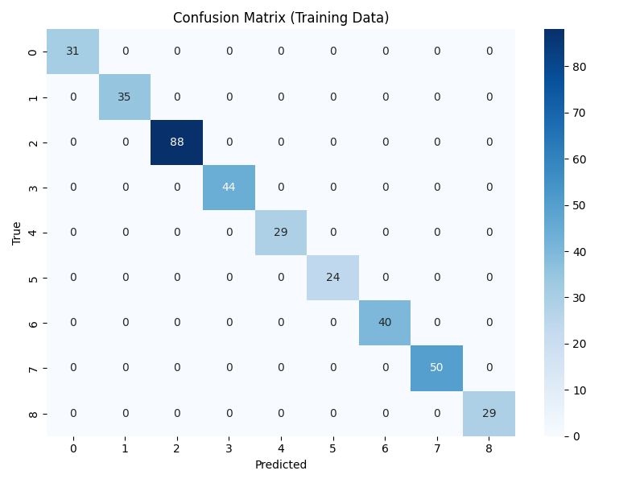
Model performance on Training set
Cross Validation
Accuracy
95.14% ± 1.8%
5-fold CV
Precision
Recall
F1-Score
1
Perfect Classification
Notes:
Precision, recall, and F1-score all being 1.0 on the training set indicates perfect classification, meaning the model predicted every block's speaker correctly. While that’s encouraging, it could also suggest overfitting. That's why I used 5-fold stratified cross-validation to get a more realistic estimate of generalization. The CV score was around 95.14%, confirming that while the model fits the training data well, there’s still room to improve robustness.

Slide 16
What I’d do with More Time
Use CNN / RNN on raw sequences
Directly feed the raw time-series (the LPC matrix per block) into a deep learning model. Preserves more of the temporal structure and dynamics of speech, potentially improving classification accuracy.
1
Explore attention or speaker embeddings
SOTA pretrained models like ECAPA-TDNN or wav2vec2 to extract speaker embeddings from raw audio.
2
Perform stratified hyperparameter tuning
Grid search or Bayesian optimization over model hyperparameters (e.g., number of trees, max depth, learning rate). Stratify folds by speaker to ensure balanced representation in training and validation.
3
Explore more robust feature extraction
MFCCs (Mel-Frequency Cepstral Coefficients), Delta and Delta Delta coefficients (vel. & acc.) and Energy & pitch features to capture missed features in higher freq.
4
Notes:
Speaker Verification Pipeline - extract embeddings per speaker; Analyze speaker confusability - overlapping acoustic profiles.

Slide 17
Key Achievements
Robust Feature Extraction for variable length sequence
05
Professional Code delivery
And analysis report
01
04
Balanced Performance Optimization
Comprehensive Data Visualization
02
03
Cross Validation Evaluation

Slide 18


Thank you
Q&A
Divyesh Jagetia

